Slide 1


Research Lab Inventory Tracker Lizzett Tapia Sumedha Bhattacharyaa Jonathan Moore Evan Ross
TA & Sponsor: Shima Hasanpour

Slide 2
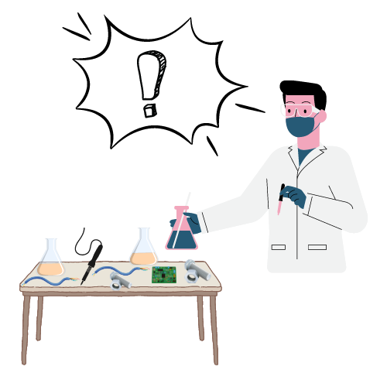
Problem Statement
“The current lab inventory tracking systems at Texas A&M are inefficient, and it is necessary to create new, organized software to increase the overall performance and efficiency of the Lab.”

Slide 3
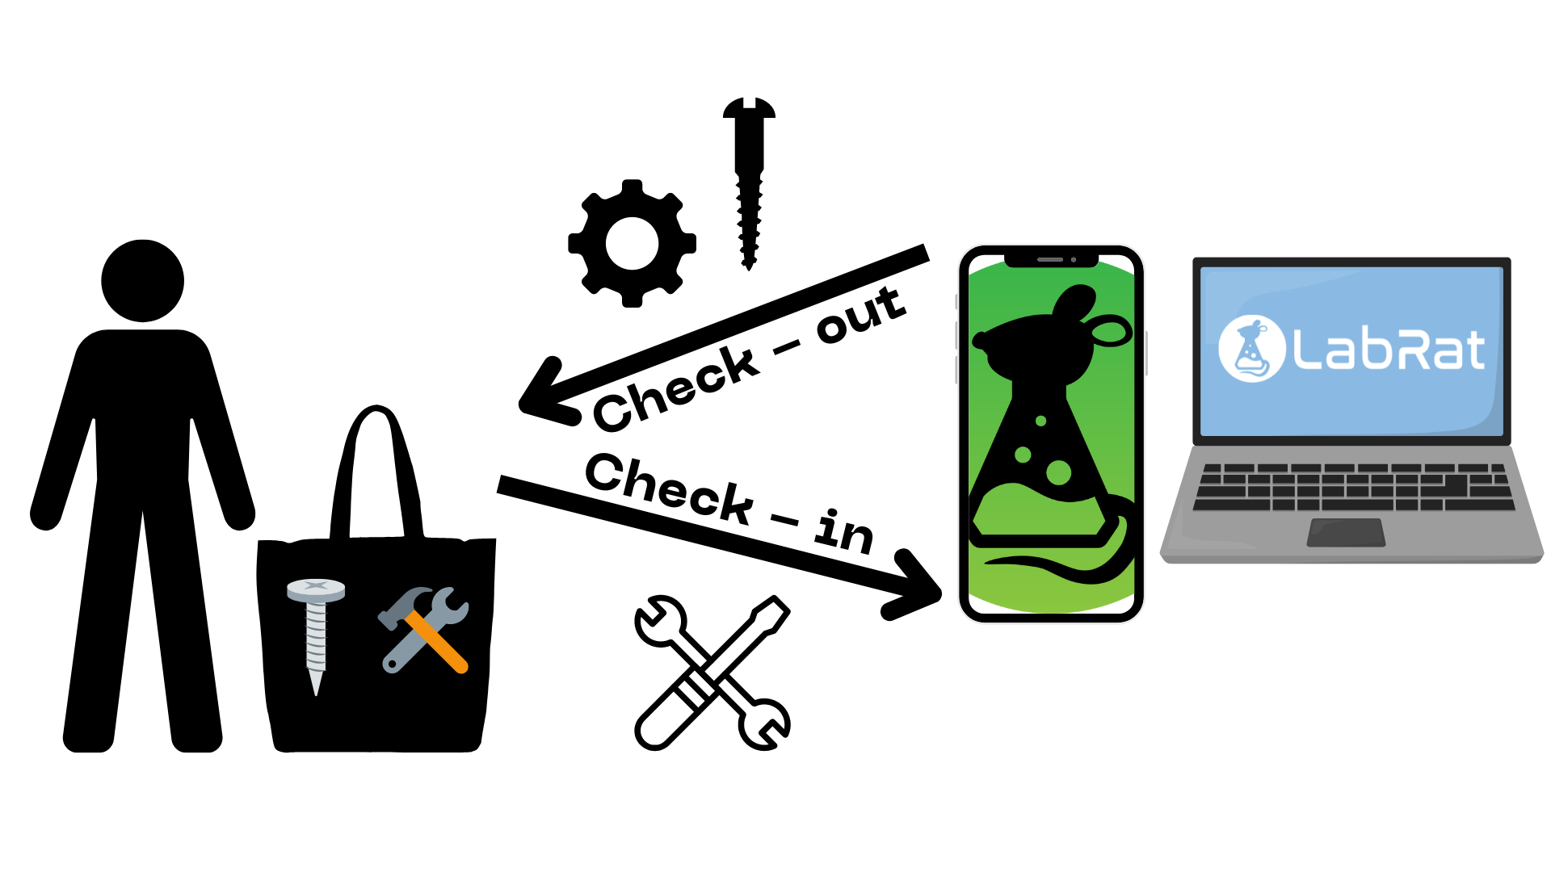
Solution Proposal
“Create a Web app and Mobile counterpart that interact with a database, so that the inventory items of TAMU labs can be intuitively identified, tracked, and altered.”

Slide 4
Interaction of Subsystems
Database
Web-App
Mobile App
Machine Learning Model
Jonathan Lizzett Sumedha Evan

Slide 5
-Database-
Lizzett Tapia
Accomplishments since the last presentation <24> hrs | Ongoing progress/problems and plans until the next presentation
- Began a Python script that helps input data into database tables, rather than inputting everything manually - Created functions that help randomly select from different categories - Got directed to a TA who was able to help out with server information | - Currently in between Amazon Aurora (Amazon Web Services) and Google Cloud Firestore - Waiting for TA input and approval - Migrate from SQLite to a full working server

Slide 6
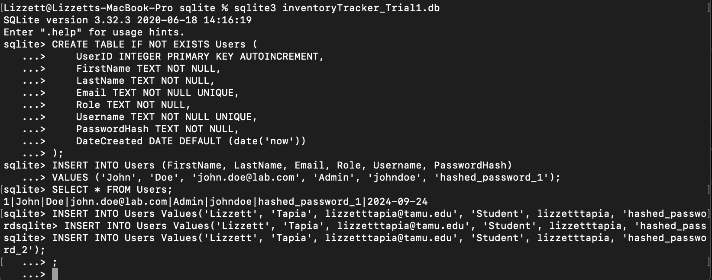
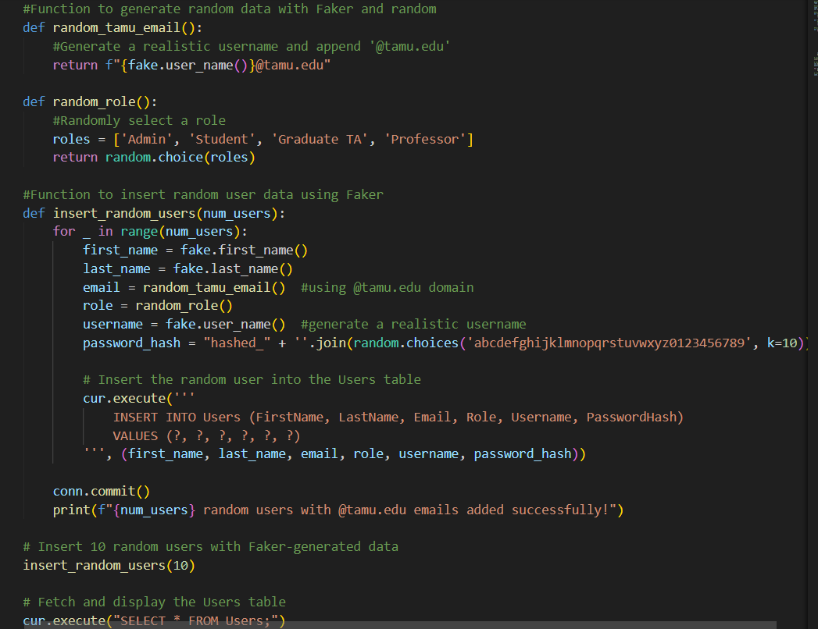

Slide 7
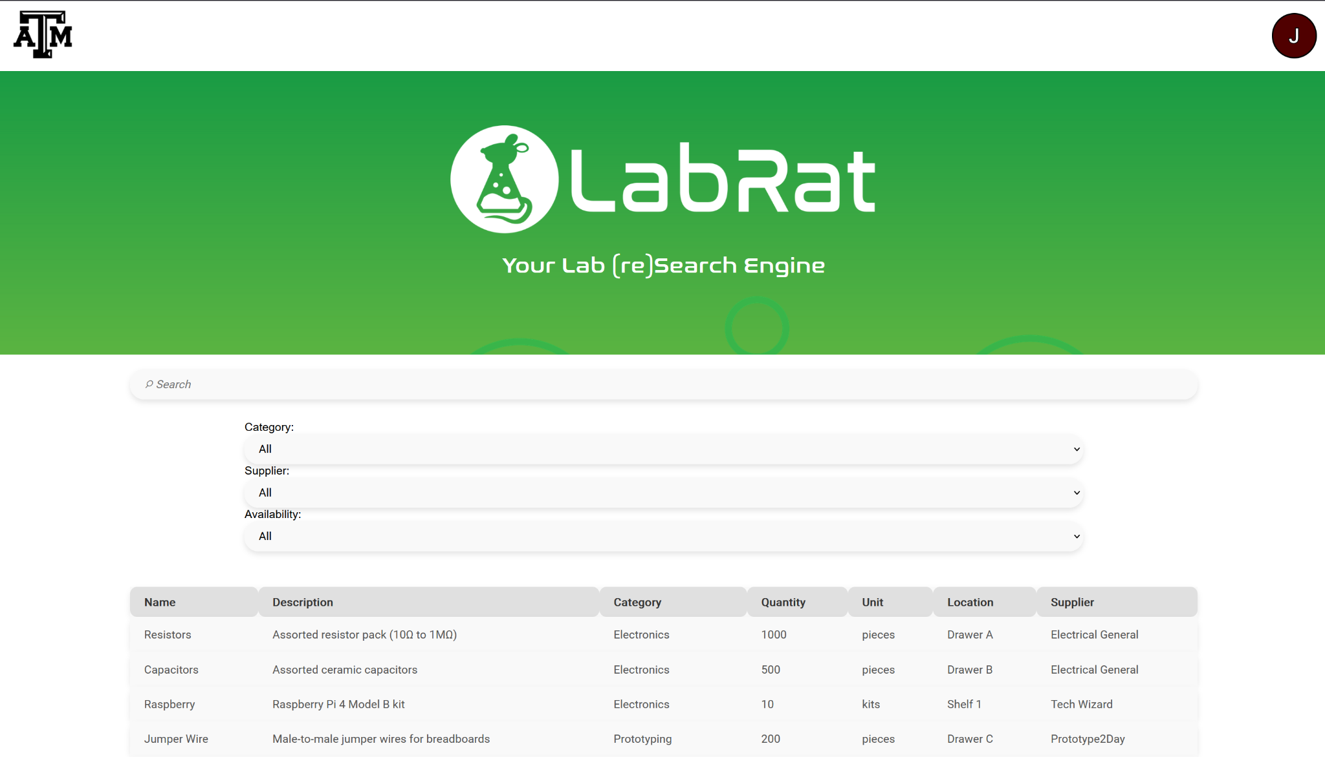
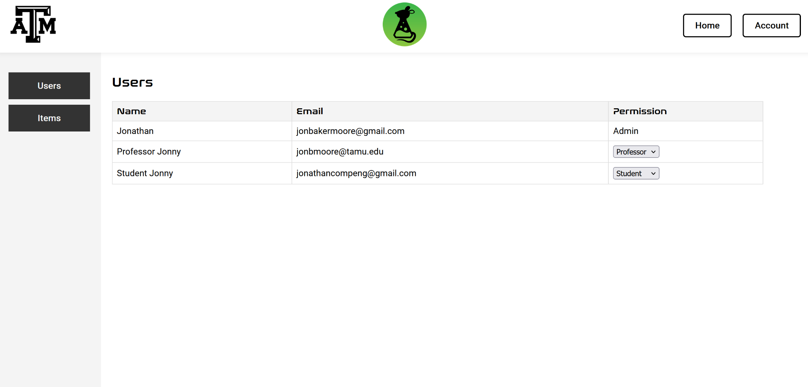
-Website-
Jonathan Moore
Accomplishments since the last presentation <27> hrs | Ongoing progress/problems and plans until the next presentation
Added ability to search/filter through items in designated lab. Added permission levels and lab management for supervisors. | Give more abilities to supervisors (editing item attributes, view user activity). Add ability to checkout items.

Slide 8
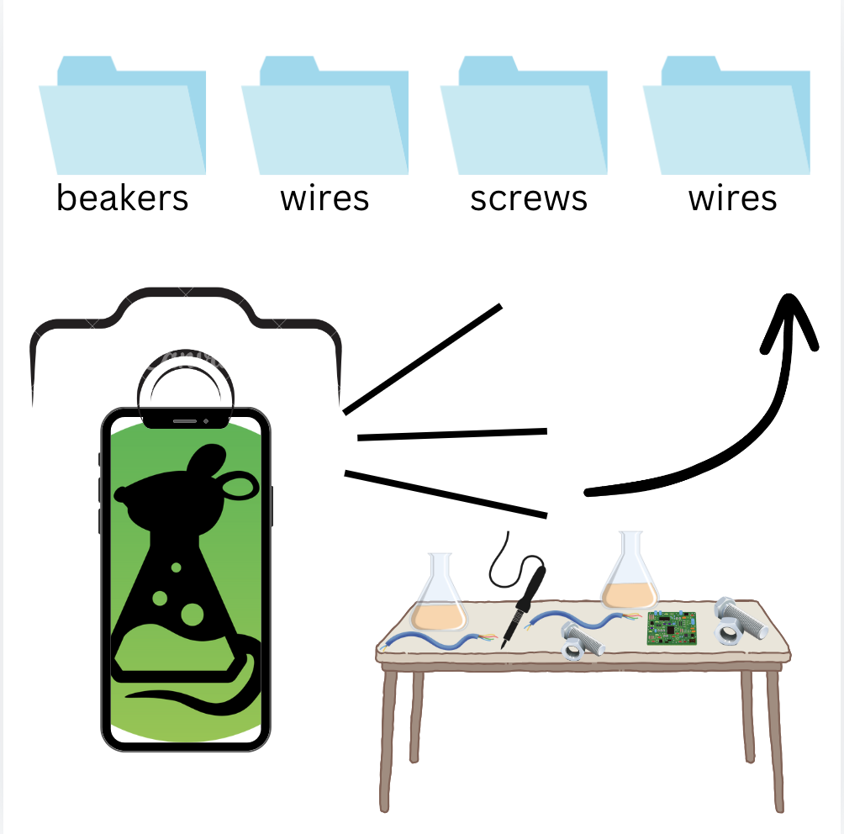
-ML Model-
Sumedha Bhattacharyaa
Accomplishments since the last presentation <21> hrs | Ongoing progress/problems and plans until the next presentation
Created a new ML Model altogether Finalized all training data sets Started on validation data sets Created function to run through all images in folder | Currently trouble shooting the model with errors in finding valid images in the dataset folders Hope to train directly after that problem is solved Then validation

Slide 9
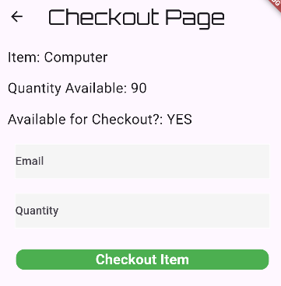
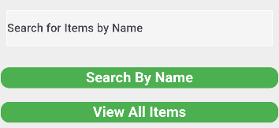
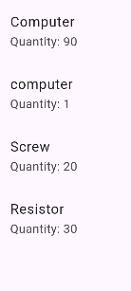
-App Development-
Evan Ross
Accomplishments since the last presentation <25> hrs | Ongoing progress/problems and plans until the next presentation
Deploy code on physical device Debug database Search and display specific items. Items displayed are selectable. Users can checkout or items which will change quantity in the database | Users will be able to check in items as well. Track which user checks out which items in a third database table.

Slide 10
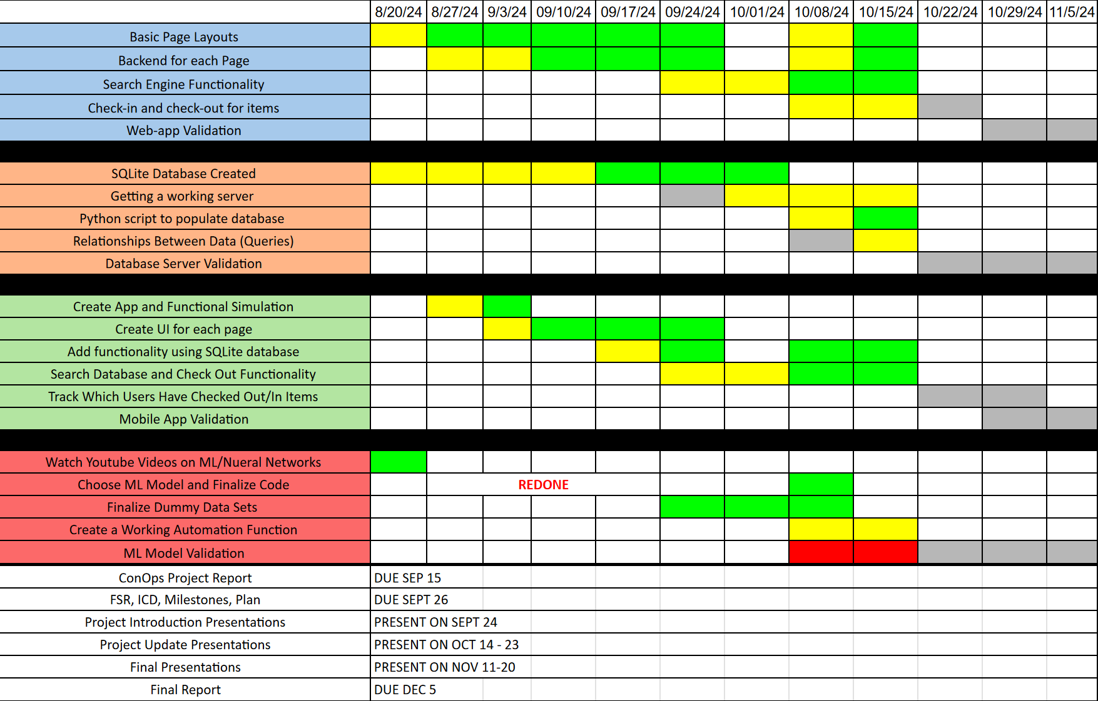
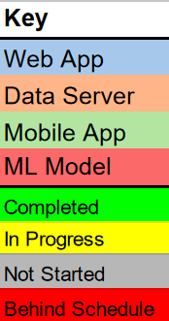
Execution plan

Slide 11
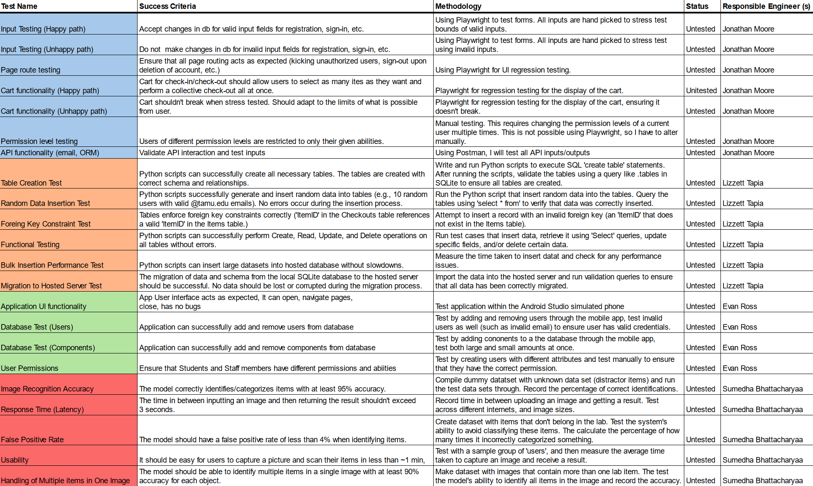
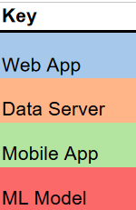
Validation plan

